Slide 1
HNDIT 2312-Principles of Software Engineering
Week 9: Cohesion and Coupling

Slide 2
Topics Covered
Modularity
Cohesion and coupling
Types of cohesion
Types of coupling

Slide 3
Modularization
Modularization is a technique to divide a software system into multiple discrete and independent modules, which are expected to be capable of carrying out task(s) independently.

Slide 4
Advantage of modularization
Smaller components are easier to maintain
Program can be divided based on functional aspects
Desired level of abstraction can be brought in the program
Components with high cohesion can be re-used again
Concurrent execution can be made possible
Desired from security aspect

Slide 5
Concurrency
concurrency is implemented by splitting the software into multiple independent units of execution, like modules and executing them in parallel.
Example-The spell check feature in word processor.

Slide 6
Coupling and Cohesion
Modules are set of instructions put together in order to achieve some tasks.
Module interaction measured by the cohesion and coupling.

Slide 7
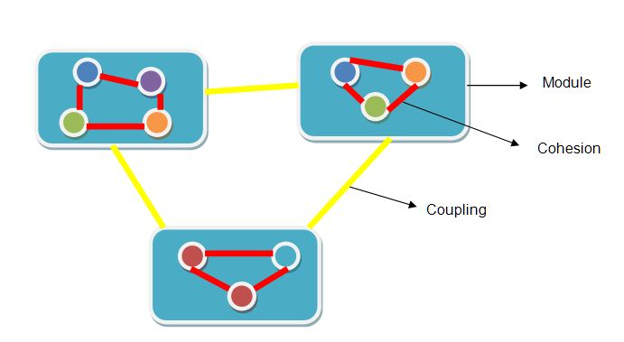
Coupling and Cohesion

Slide 8
Cohesion
Cohesion is a measure that defines the degree of intra-dependability within elements of a module.

Slide 9
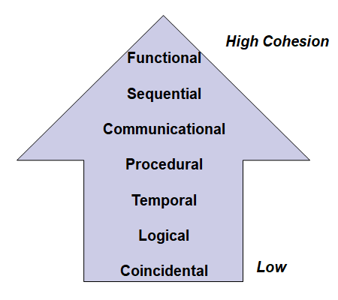
Types of cohesion

Slide 10
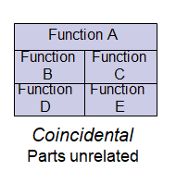
Coincidental Cohesion
Parts of the component are unrelated (unrelated functions, processes, or data).
Elements needed to achieve some functionality are scattered throughout the system.

Slide 11
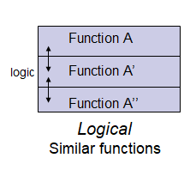
Logical cohesion
Elements of component are related logically and not functionally.

Slide 12
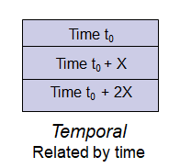
Temporal Cohesion
Elements are related by timing involved.
Example: An exception handler that
Closes all open files
Creates an error log
Notifies user

Slide 13
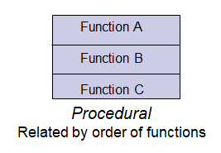
Procedural Cohesion
Elements of a component are related only to ensure a particular order of execution.
Example:
Write output record
Read new input record
Pad input with spaces
Return new record

Slide 14
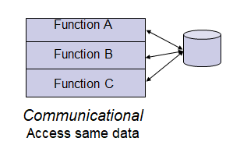
Communicational Cohesion
Functions performed on the same data or to produce the same data.

Slide 15
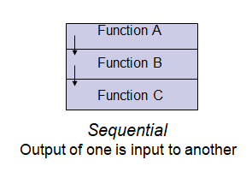
Sequential Cohesion
The output of one part is the input to another.
Data flows between parts (different from procedural cohesion)

Slide 16
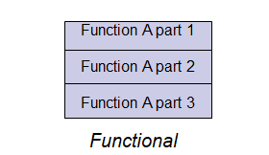
Functional Cohesion
Elements of module in functional cohesion are grouped because they all contribute to a single well-defined function.
It can also be reused.

Slide 17
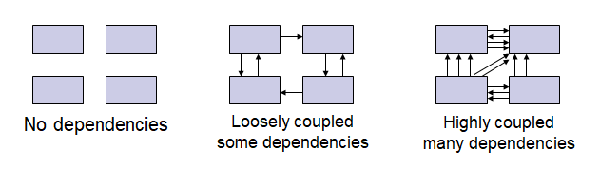
Coupling
Coupling is a measure that defines the level of inter-dependability among modules of a program.

Slide 18
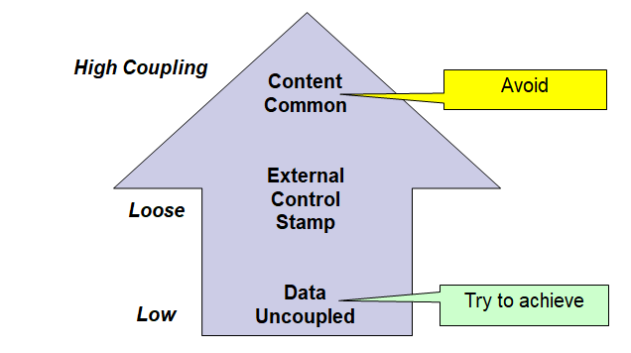
Types of coupling

Slide 19
Content coupling
When a module can directly access or modify or refer to the content of another module.
Two modules are content coupled if
one module changes a statement in another (Lisp was famous for this ability)
one module references or alters data contained inside another module
one module branches into another module

Slide 20
Common coupling
When multiple modules have read and write access to some global data.

Slide 21
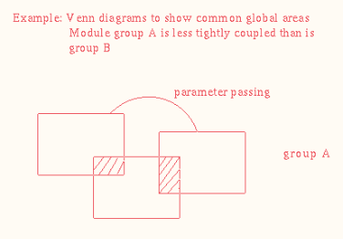
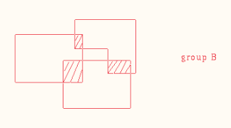
Example-common coupling

Slide 22
Control coupling
Two modules are called control-coupled if one of them decides the function of the other module or changes its flow of execution.

Slide 23
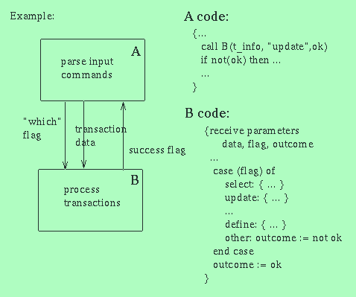
Control coupling

Slide 24
Stamp coupling
When multiple modules share common data structure and work on different part of it, it is called stamp coupling.

Slide 25
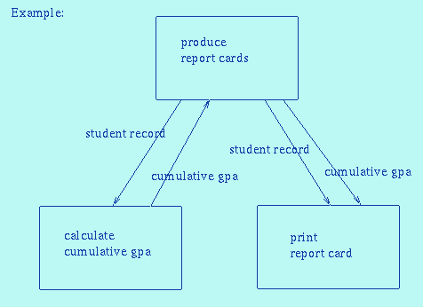
Example-stamp coupling

Slide 26
Data coupling
Data coupling is when two modules interact with each other by means of passing data (as parameter).

Slide 27
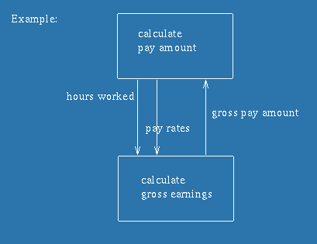
Example-Data coupling

Slide 28
Characteristics of Good Design
Component independence
High cohesion
Low coupling
Exception identification and handling
Fault prevention and fault tolerance
Design for change

Slide 29
Key points
As for coupling, it refers to how related or dependent two classes/modules are toward each other.
Cohesion refers to what the class (or module) can do.
Good software design has high cohesion and low coupling.

